Slide 1

Effects of Temperature and the Pandemic on Crimes
Based on reported crimes: 2017 - 2021

Slide 2
Data Reporting Issues
Crime undercounts: Absence of crime reporting
According to the U.S. Bureau of Justice Statistics (BJS), there is a failure to note how much crime nationally, including Chicago, goes unreported to police by victims.
Improved reporting of crime statistics in Chicago occurred in late 2021
Change in how crime statistics are collected
2021 local authorities were supposed to switch from the old system to the new system, the National Incident-Based Reporting System (Nibrs).
The old system uses a hierarchy to report the most serious crime while omitting other crimes reported for the same incident.
Nibrs collects more details and multiple offenses for a single incident
In Chicago, some important crime categories are not included in the police department’s Compstat “Part 1” weekly crime summaries. Under Compstat, when multiple crimes are committed under 1 incident, only the most serious crime is counted. Nibrs correct this. Chicago started conversion to Nibrs in June of 2021.

Slide 3
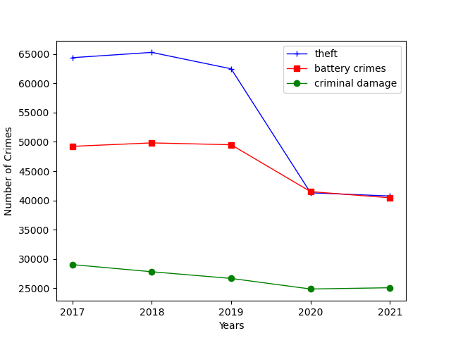
Primary Crime Types - Summary
Top 3 Primary Crime Types by Year
The city of Chicago’s Data Portal tabulates all reported crimes, apart from murder, which are then categorized by primary types
The database contain data that dates as far back as 2001
Our Analysis is based on five years of data, from 2017 to 2021
Three primary types of crime constantly ranked as the most reported: theft, battery, and criminal damage
They aggregately account for roughly 53% of all primary types of crimes each year

Slide 4
2020 Pandemic Impact
The top three primary crimes consistently accounted for between 52% and 56% of all crimes reported from 2017 to 2021
During that same period, crimes overall remained around the same level between 2017 and 2019, before dropping drastically in 2020
The unusual drop in 2020 and 2021, relative to the norm through 2019, can be attributed to the effect of the COVID pandemic and the ramifications resulting from confinement requirements that were observed in the city as a precautionary measure

Slide 5
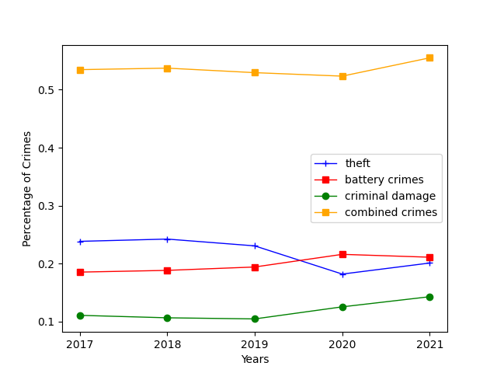
Top Primary Crimes - Distribution
As a percentage of all crimes, theft accounted for the most frequently occurred, followed by battery, and criminal damage
During 2020 and 2021, theft occurrences was surpassed by battery for the first time, compared to historical norms
Primary Crime Types % of all Crimes

Slide 6
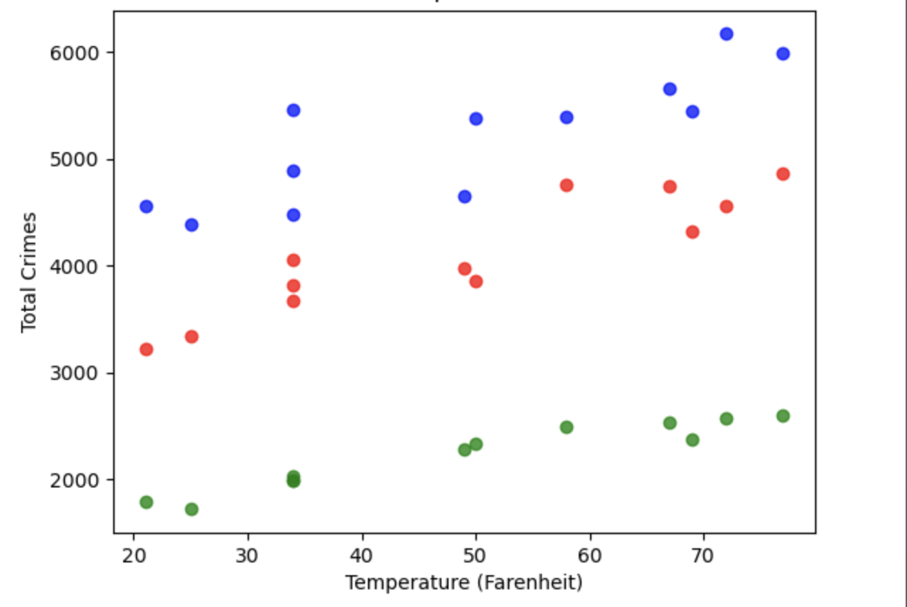
Weather Impact on Crimes
Top 3 Crimes 2019
Top 3 Crimes vs Temperature in 2019
The top 3 primary crimes reported in 2019 were analyzed and graphed based on a range of averaged cold and warm temperatures at the time they were committed to determine any possible correlation
The correlation for the top three crimes combined is .905, a strong correlation which suggests that the total number of those crimes increases as the temperature rises
The p-value for all three crimes is .0004 which is less than .05 (statically significant)

Slide 7
2017-2018 Trends
Top 3 Crimes 2017
Top 3 Crimes 2018
As you can see all three major crimes continue to increase as the temperature of Chicago rises throughout the year.

Slide 8
2019-2020 Trends
Top 3 Crimes 2019
Top 3 Crimes 2020
This trend continues in 2019 before we see the impact of the pandemic in 2020.

Slide 9
2021Trends
The statistics reversed to the pre-pandemic trend in 2021.

Slide 10
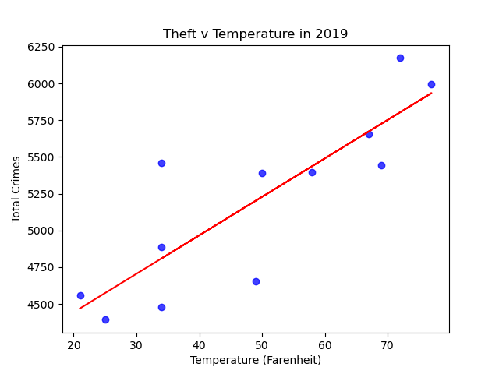
Theft & Temperature - Regression
The correlation coefficient for theft relative to the weather 2019 is .846, which suggests a strong correlation. As the temperature gets warmer, the number of thefts reported increases
The p-value for this graph is .0005 which is less than .05 (statically significant)

Slide 11
2017-2018 Homicides Trends

Slide 12
2019-2020 Homicides Trends

Slide 13
2021 Homicides Trends
Homicide rates did not decrease due to the COVID Pandemic.

Slide 14
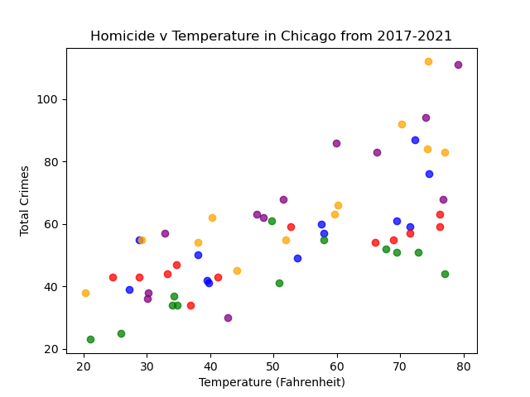
Temperature & Homicide Correlation
The correlation for homicides relative to the warm temperature between 2017 and 2020 is .882, which implies a strong correlation between the two
Over the course of the 4-year period, the warmer the weather, the more homicides that were observed
The p-value for this graph is .001 which is less than .05 (statically significant)

Slide 15
Conclusion
What does this analysis mean?
Our group’s theory had been that changes in weather could possibly affect crime rates. We theorized that warmer weather would see a higher increase in crime and colder weather should see crime rates reduced. We based our analysis on 5 years of crime data statistics for the city of Chicago. The analysis proved our initial assumption to be true based on the strong correlation coefficients resulting from our observation of the data.
Why should we care?
Being able to predict when crime rates increase will provide communities with a way to implement crime reducing tactics. This can include increasing the number of police officers or concentrating more police coverage to troubled sections of the community. Using predictive analysis such as monitoring weather patterns on crime rates could have helped police departments get ahead and potentially stop crime before it happens.

Slide 16
Index – Links of Datasets for Analysis
https://data.cityofchicago.org/Public-Safety/Homicides/iyvd-p5ga/data
https://data.cityofchicago.org/Public-Safety/Crimes-2001-to-Present/ijzp-q8t2/data
https://www.weather.gov/wrh/Climate?wfo=lot
https://wirepoints.org/chicago-crime-statistics-even-worse-than-you-think-wirepoints/
https://www.wsj.com/articles/why-we-dont-know-if-violent-crime-rose-or-fell-lastyear-11666344602

